Slide 1
Stock Market Price Prediction
Prepared By :
M. Abdullah Khalid
Presented To:
Sir Saeed

Slide 2
INTRODUCTION:
The topic of my regression project is stock Market price prediction. this project is basically about the stock market price prediction in which this project predicts the price of currency pair by giving the details of the currency pair which include details like.
Open Price
Mid Price
Low Volume
High volume

Slide 3

Data Set:
This shows the data set of stock Market which is taken from keggle .com.
In the given picture code loads the data set of stock market and shows the attributes of data set.

Slide 4


Handling Missing Values
This checks for missing values in the DataFrame and drops any rows that contain them.
Feature Selection and Dataset Preparation
This selects relevant columns (Open, High, Low, Volume, Close) and ensures there are no missing values.

Slide 5
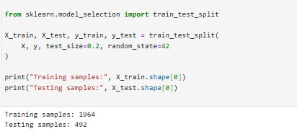
Train-Test Split:
In the given figure this show the testing and training of data set in which the training samples are 1964 and testing samples are 492.

Slide 6
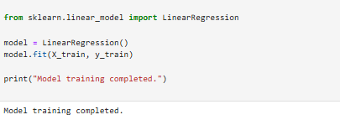
Model Selection
A Linear Regression model is chosen.
It is trained using the training data (X_train, y_train).

Slide 7
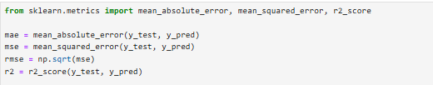
Evaluation:
The model performance is evaluated using:
MAE (Mean Absolute Error)
RMSE (Root Mean Squared Error)
R² (R-squared Score)

Slide 8

Conclusion:
In the end I would like to say that this project predicts the closing price of a specific currency pair by input the following details .
Open Price – The stock’s opening price for the day
High Price – The highest price of the stock during the day
Low Price – The lowest price of the stock during the day
Volume – The number of shares traded during the day
Here is the following Output of the stock market close price
prediction.

